Slide 1
CAGE: Continuity-Aware edGE Network Unlocks Robust Floorplan Reconstruction
Yiyi Liu¹, Chunyang Liu¹, Bohan Wang¹, Weiqin Jiao², Bojian Wu³, Lubin Fan³, Yuwei Chen⁴, Fashuai Li^{5,*}, Biao Xiong^{1,*}
¹Wuhan University of Technology
²University of Twente
³Independent Researcher
⁴Hangzhou Institute for Advanced Study, University of Chinese Academy of Sciences
⁵The Advanced Laser Technology Laboratory of Anhui Province
Notes:
We present our work: CAGE: Continuity-Aware edGE Network Unlocks Robust Floorplan Reconstruction

Slide 2
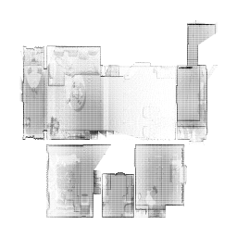
Our pipeline: from point cloud to density map to vectorized output：
3D point clouds
Density map
Vectorized Floorplan

Slide 4
Boundary Ambiguity
ROI Confusion
Dependency on initial proposals
Slow inference
Corner Intersections
Difficulties with non-Manhattan layouts

Slide 5
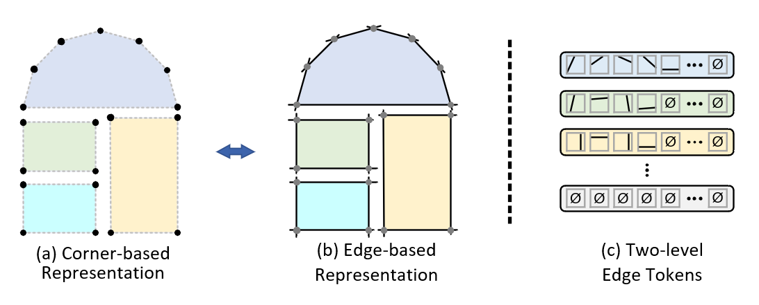
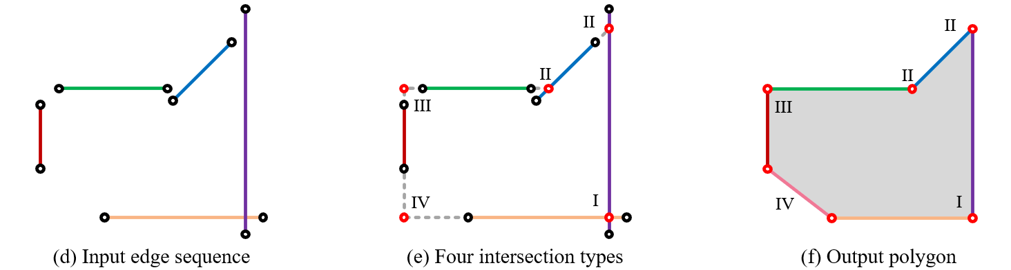
Proposed Continuity-Aware Edge Representation：

Slide 6
Architecture of the CAGE network

Slide 7
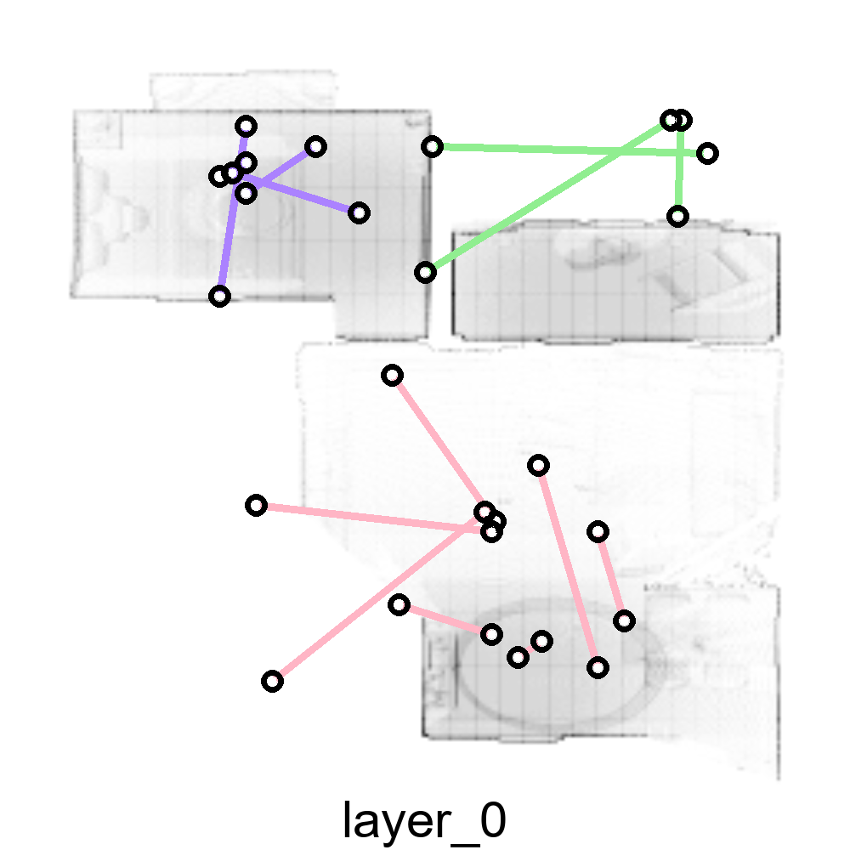
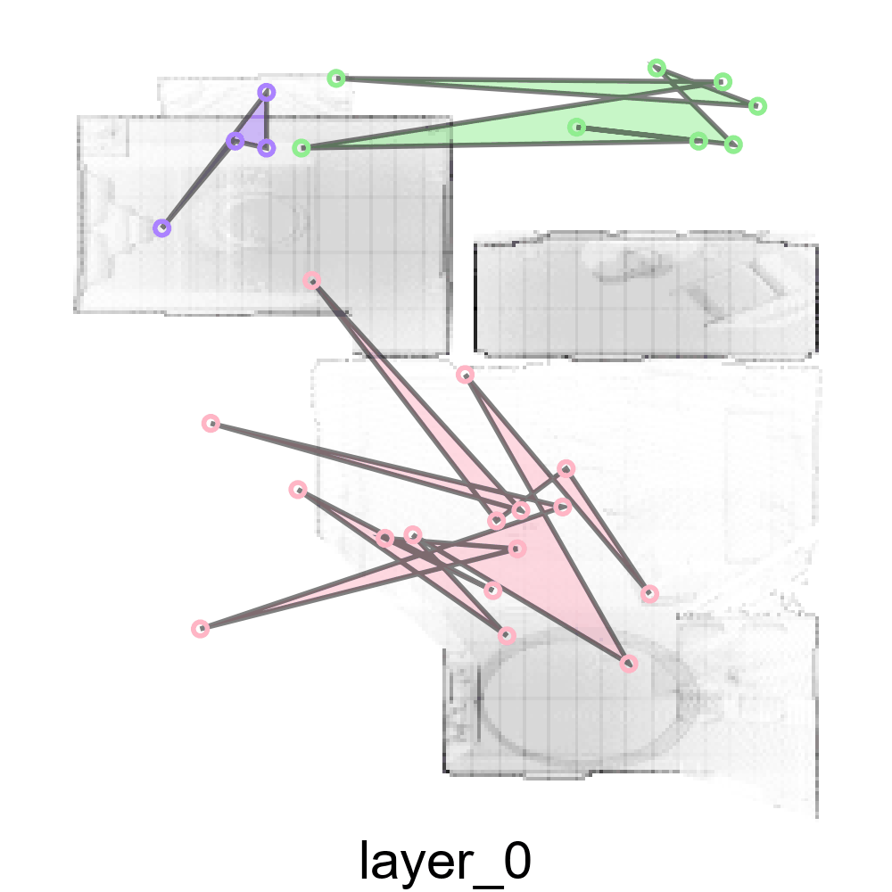
Decoder
ith Layer in the Decoder

Slide 8
Comparison with SOTA - Structured3D
+1.5
+2.4
Inference
Time(s)
0.11 0.01 0.17 0.02 0.09 0.04 - 0.01

Slide 9
Comparison with SOTA - Structured3D
Even under severe occlusions or irregular room shapes, our method still produces vectorized floorplans that closely match the ground truth.

Slide 10
Comparison with SOTA - SceneCAD

Slide 11
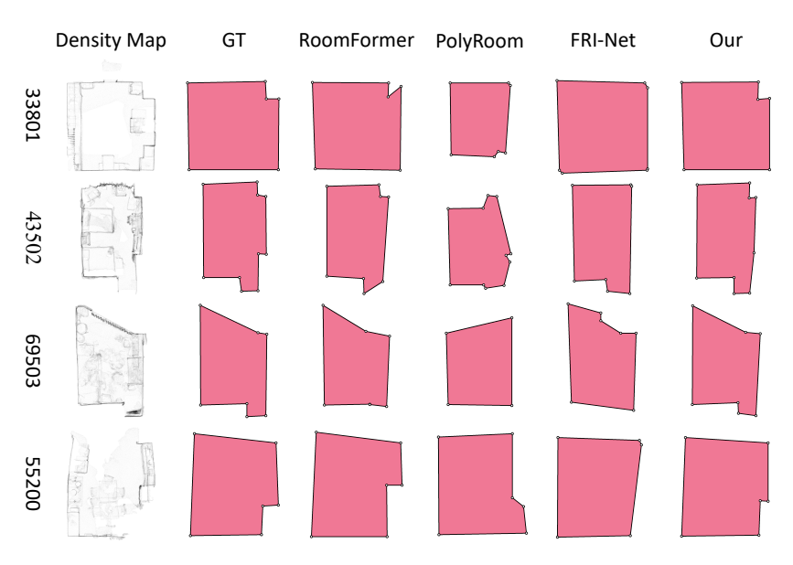
Comparison with SOTA - SceneCAD

Slide 12
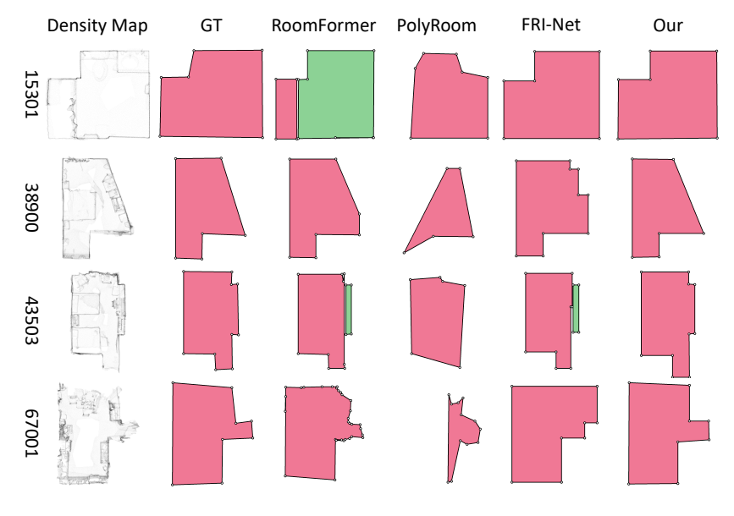
Cross-data generalization
Models are trained on Structured3D train set but evaluated on SceneCAD val set.
+0.4
-2.2
+1.0

Slide 13
CAGE: Continuity-Aware edGE Network Unlocks Robust Floorplan Reconstruction
Yiyi Liu¹, Chunyang Liu¹, Bohan Wang¹, Weiqin Jiao², Bojian Wu³, Lubin Fan³, Yuwei Chen⁴, Fashuai Li^{5,*}, Biao Xiong^{1,*}
¹Wuhan University of Technology
²University of Twente
³Independent Researcher
⁴Hangzhou Institute for Advanced Study, University of Chinese Academy of Sciences
⁵The Advanced Laser Technology Laboratory of Anhui Province
Notes:
We present our work: CAGE: Continuity-Aware edGE Network Unlocks Robust Floorplan Reconstruction

